Slide 1
EXPLORATORY DATA ANALYSIS ON LARGEST COMPANIES DATASET
EXPLORATORY DATA ANALYSIS
Presented By :
Barde, Bhavesh Pravin
Kunchala, Brunai
Mamidi, Vamshidhar Reddy
Palla, Yaswanth

Slide 2
What Is Exploratory Data Analysis (EDA) ??
Exploratory Data Analysis (EDA) involves conducting preliminary investigations of data to uncover patterns,
identify anomalies, test hypotheses, and validate
assumptions using summary statistics and visualizations.
It is essential to first comprehend the data thoroughly
and extract as many meaningful insights as possible.

Slide 3
abstract:
This study analyzes a dataset of the world’s largest companies to uncover trends and predict company profitability using machine learning models. Through exploratory data analysis (EDA), relationships between financial metrics such as sales, profits, and market value were visualized. Machine learning models, including Linear Regression, Decision Tree, and Random Forest, were implemented to predict company profit based on key attributes. The findings reveal that Random Forest Regressor provided the best predictive performance, with sales being the most important feature. This report outlines the methodology, results, and key insights while providing actionable recommendations for business applications.

Slide 4
INTRODUCTION:
The business world constantly seeks insights to drive growth and profitability. With the rapid evolution of industries and globalization, understanding financial trends among the world’s largest companies is essential.
This report explores a comprehensive dataset of the largest global companies, focusing on profitability trends and predictions. The specific objectives include:
- Identifying key patterns and trends in financial metrics.
- Establishing correlations between sales, assets, and market value.
- Building machine learning models to predict company profitability.
- Deriving actionable insights for strategic decision-making.

Slide 5
Dataset Overview:
Content:
Dataset Summary:
2001 rows and 12 columns.
Key metrics: Rank, Sales, Profit, Assets, Market Value, Industry, Employees.
Challenges:
Missing values in non-financial fields: Industry, Founded, Headquarters.
Visual: Tabular view of dataset features.

Slide 6
Pre-processing
Steps Taken:
Missing Data Handling:
Rows with missing values were removed for simplicity.
Future iterations could explore imputation strategies for handling missing data.
Feature Transformation:
Converted financial columns such as Sales, Profit, Assets, and Market Value to numeric types for consistency.
Feature Selection:
Selected numerical features (Sales, Assets, Market Value, Employees) as predictors.
Defined Profit as the target variable for machine learning models.
Data Standardization:
Normalized financial metrics to address skewness and reduce the impact of outliers.

Slide 7
Key Insights from EDA:
Content:
Distributions:
Sales and Profit are positively skewed.
Outliers exist in financial metrics.
Correlation:
Strong positive relationships between Sales, Profit, and Market Value.
Weak correlation with Employees. Visual: Correlation heatmap and distribution histograms.

Slide 8
Machine Learning Models:
Linear Regression:
Suitable for predicting continuous variables using a linear combination of input features.
Decision Tree Regressor:
Captures non-linear relationships and handles categorical data effectively.
Random Forest Regressor:
An ensemble method combining multiple decision trees to improve prediction accuracy and reduce overfitting.

Slide 9
Model Performance
Content:
Metrics:
Linear Regression: MSE =4.4573, R2R2 = 0.6399.
Decision Tree: MSE = 10.3656, R2R2 = 0.1626.
Random Forest: MSE = 2.6881, R2R2 = 0.7828.
Best Model: Random Forest outperforms others with the highest accuracy.
Visual: Bar chart comparing model performances.

Slide 10
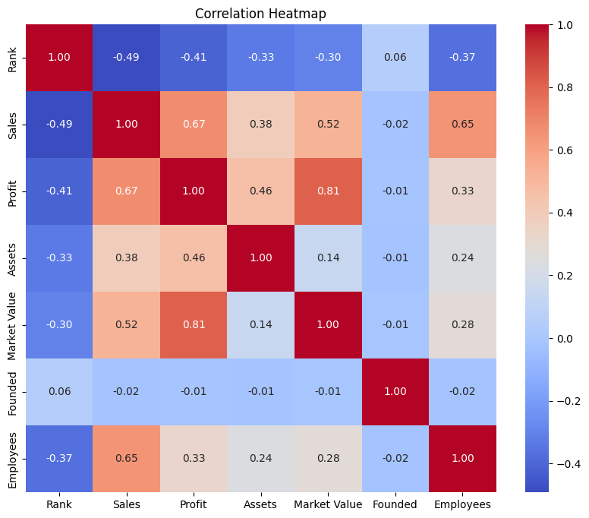

Slide 11
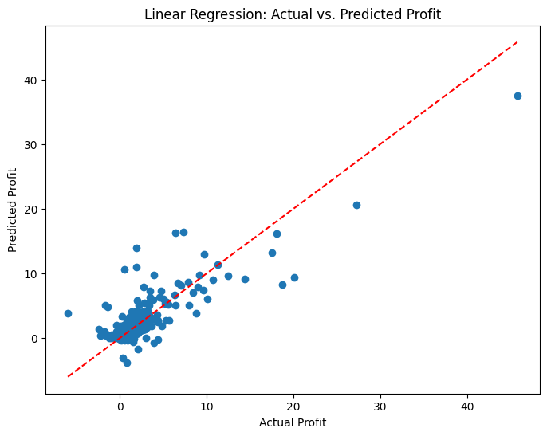
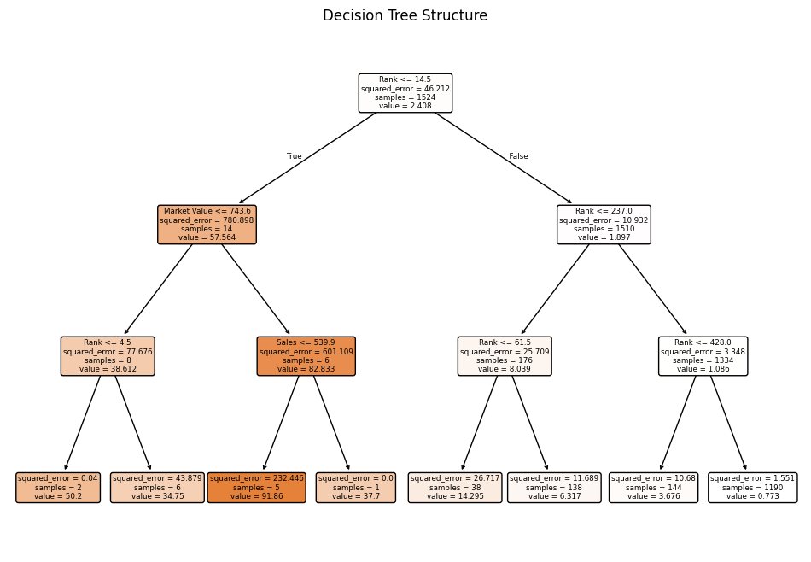

Slide 12
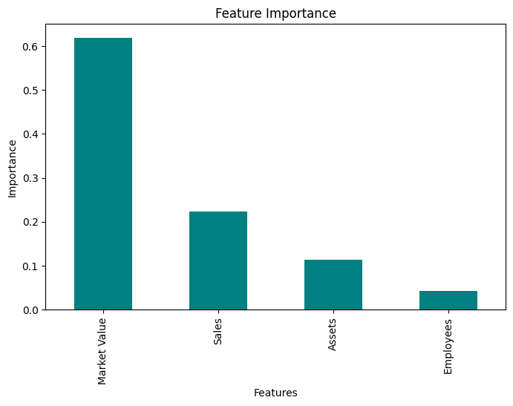
Feature Importance (Random Forest):
Sales: Most significant predictor of Profit.
Market Value and Assets: Secondary contributors.
Employees: Least influential, likely due to weak correlation with profitability.

Slide 13
Conclusion :
This study provided actionable insights into financial metrics of global companies, highlighting:
Sales as the strongest determinant of profitability.
Random Forest Regressor as the best-performing model with an score of 0.89.
The importance of robust data preprocessing, especially for handling missing values and outliers.

